Slide 1
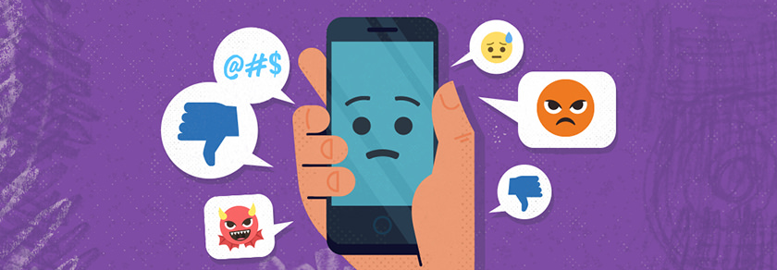
Cyberbullying: How Machine Learning Can Help!
Team #8
Aaron, Nary, Roopa, Tyler

Slide 2
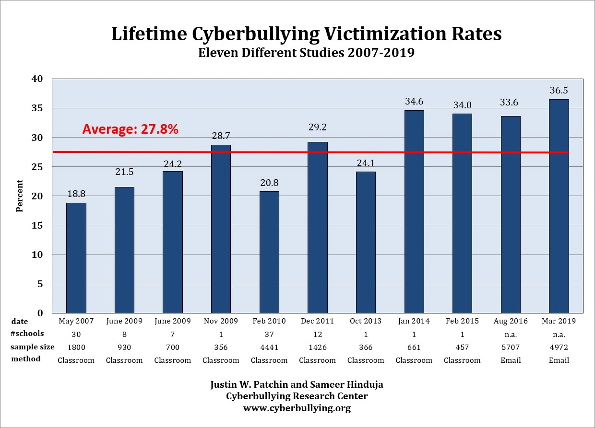

Slide 3
Real Tweet #1
“YOU STUPID WHORE I HOPE YOU ARE IN YOUR HOUSE WHEN I BURN DOWN YOUR HOUSE YOU STUPID WHORE WHY WOULDN'T YOU GO TO PROM WITH ME”

Slide 4
Real Tweet #2
“you never posted your blog. and today is guest blog day. get with the program my slut pink zebra. LOL loveee you anyway!”

Slide 5
Real Tweet #3
“The hormones are worse for guys. I can't tell you how much I truly hate the thoughts that go through my head”

Slide 6
Real Tweet #4
“yeah we all call her a whore and shes all don't call me that! So i called her a slut. And she said im a tease! And i told her ...”

Slide 7
Real Tweet #5
“lol exactly. \Hey guys how about a 13-sided paralellogram? THAT'LL fuck em up!”

Slide 8
Real Tweet
"The hormones are worse for guys. I can't tell you how much I truly hate the thoughts that go through my head.“
"Faggoty fag fag. Gay secks man blowjob. Settle down.“
"Have you tried 'fuck' and 'Fuck'? (yes they are different)“
"you never posted your blog. and today is guest blog day. get with the program my slut pink zebra. LOL loveee you anyway!“
"yeah we all call her a whore and shes all don't call me that! So i called her a slut. And she said im a tease! And i told her ...“
"told ya she was fat! she's loyal tho she has this goin for her..."

Slide 9
Real Tweet
"YOU STUPID WHORE I HOPE YOU ARE IN YOUR HOUSE WHEN I BURN DOWN YOUR HOUSE YOU STUPID WHORE WHY WOULDN'T YOU GO TO PROM WITH ME“
"oh guess who got an australian shephard puppy today. note: NOT ME. the other roommate. yeah. another. fucking. dog.“
"lol exactly. \"Hey guys how about a 13-sided paralellogram? THAT'LL fuck em up!"

Slide 10

How Machine Learning Can Help!
Using Natural Language Processing, we can build a machine learning model to analyze social media comments to detect cyber bullying.
Natural Language Processing (NLP): a field in machine learning with the ability of a computer to understand, analyze, manipulate, and potentially generate human language.

Slide 11
Real Tweet #1
“YOU STUPID WHORE I HOPE YOU ARE IN YOUR HOUSE WHEN I BURN DOWN YOUR HOUSE YOU STUPID WHORE WHY WOULDN'T YOU GO TO PROM WITH ME”
Rating: 1

Slide 12
Real Tweet #2
“you never posted your blog. and today is guest blog day. get with the program my slut pink zebra. LOL loveee you anyway!”
Rating: 1

Slide 13
Real Tweet #3
“The hormones are worse for guys. I can't tell you how much I truly hate the thoughts that go through my head”
Rating: 1

Slide 14
Real Tweet #4
“yeah we all call her a whore and shes all don't call me that! So i called her a slut. And she said im a tease! And i told her ...”
Rating: 1

Slide 15
Real Tweet #5
“haha fuck i wish i was there :(”
Rating: 0

Slide 16
There’s still learning to be had!
Learning a new language is hard! There are cultural nuances, intonations, and
H

Slide 17
Real Tweet False positive
“lol exactly. \Hey guys how about a 13-sided paralellogram? THAT'LL fuck em up!”
Rating: 1

